Slide 1



Introduction to Node.js
WWW, HTTP, Node.js Overview, Servers
SoftUni Team
Technical Trainers
Software University
http://softuni.bg

Slide 2
Table of Contents
IDE Setup
WWW, Web Site, URL
HTTP
Data Forms
HTML, CSS, JSON
Dev Tools
Node.js Overview
Modules
Node.js Web Server

Slide 3
Have a Question?
sli.do #js-web

Slide 4





IDE Setup
Development Environments for Node.js

Slide 5




Configuring Visual Studio Code
Download from https://code.visualstudio.com/
Official Node.js instructions can be found at:
Recommended linters:
https://code.visualstudio.com/docs/runtimes/nodejs

Slide 6

WWW and URL
What is WWW? What is URL?

Slide 7

What is WWW?
WWW = World Wide Web = Web
Global distributed information system in Internet
Consists of set of documents (and other resources) located on different Internet servers
Web servers provide Web content
Web browsers display the Web content

Slide 8


WWW Structural Components
Structural components
Internet – provides data transfer channels over the TCP and HTTP protocols
Clients (Web browsers) – display Web content
Web servers – IIS, Apache, Tomcat, GWS, etc.
Web Client
Web Server

Slide 9
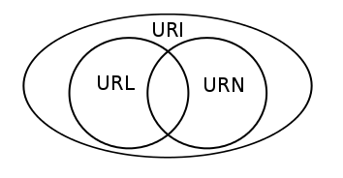


WWW Semantic Components
Semantic components
Hyper Text Transfer Protocol (HTTP)
Hyper Text Markup Language (HTML)
Uniform Resource Locator (URL)
Uniform Resource Identifiers (URIs)

Slide 10

WWW Infrastructure
Clients use Web browser application to request resources from the Web servers via HTTP
Servers send the requested resource as a response
Web pages are resources in WWW
Web sites are sets of Web pages in WWW

Slide 11
Web Site Components
Web Page
Home
Web Site
About
Contacts

Slide 12
Uniform Resource Locator (URL)
http://mysite.com:8080/demo/index.php?id=27&lang=en#lectures
Query String
Protocol
Host
Port
Path
Fragment
URL is a formatted string, consisting of:
Protocol for communicating (http, ftp, https...) – HTTP in most cases
Host or IP address (www.softuni.bg, gmail.com, 127.0.0.1, web)
Port (the default port is 80) – a number in range [0…65535]
Path (/forum, /path/index.php)
Query string (?id=27&lang=en)
Fragment (#lectures) – used on the client to navigate to some section

Slide 13
URL Encoding
URLs are encoded according RFC 1738:
All other characters are escaped with the formula:
Example: space has decimal code 32, in hex – 20, so space in URL becomes %20
Space can also be encoded as "+"
"... Only alphanumeric [0-9a-zA-Z], the special characters $-_.+!*'() and reserved characters used for their reserved purposes may be used unencoded within an URL."
%[character hex code in ISO-Latin character set]

Slide 14
URL – Examples
Some valid URLs:
Some invalid URLs:
http://www.google.bg/search?sourceid=navclient&ie=UTF-8&rlz=1T4GGLL_enBG369BG369&q=http+get+vs+post
http://bg.wikipedia.org:80/wiki/%D0%A2%D0%B5%D0%BB%D0%B5%D1%80%D0%B8%D0%B3
http://www.google.bg/search?&q=C# .NET 4.0
http://www.google.bg/search?q=C%23+.NET+4.0
http://www.google.bg/search?&q=бира
http://www.google.bg/search?q=%D0%B1%D0%B8%D1%80%D0%B0

Slide 15

The HTTP Protocol
How HTTP Works?

Slide 16
HTTP Definition
Hyper Text Transfer Protocol (HTTP)
Client-server protocol for transferring Web resources (HTML files, images, styles, etc.)
Important properties of HTTP
Request-response model
Text-based format
Relies on a unique resource URLs
Provides resource metadata (e.g. encoding)
Stateless (cookies can overcome this)
16

Slide 17
HTTP: Request-Response Protocol
Client program
Running on end host
E.g. Web browser
Requests a resource
Server program
Running at the server
E.g. Web server
Provides resources
GET /index.html
HTTP/1.0
HTTP/1.0 200 OK
"Welcome to our
Web site!"

Slide 18
Example: Hyper Text Transfer Protocol
HTTP request:
HTTP response
GET /courses/about.aspx HTTP/1.1
Host: www.softuni.com
User-Agent: Mozilla/5.0
<CRLF>
End of request header
HTTP/1.1 200 OK
Date: Mon, 5 Jul 2010 13:09:03 GMT
Server: Microsoft-HTTPAPI/2.0
Last-Modified: Mon, 12 Jul 2010 15:33:23 GMT
Content-Length: 54
<CRLF>
<html><title>Hello</title>Welcome to our site</html>
18

Slide 19
HTTP Request Message
Request message sent by a client consists of
Request line – request method (GET, POST, HEAD, ...), resource URI, and protocol version
Request headers – additional parameters
Body – optional data
E.g. posted form data, files, etc.
<request method> <resource> HTTP/<version>
<headers>
<empty line>
<body>
19

Slide 20
HTTP Request Methods
HTTP defines methods to indicate the desired action to be performed on the identified resource
Method | Description
GET | Retrieve / load a resource
POST | Create / store a resource
PUT | Update a resource
DELETE | Remove a resource
20

Slide 21
HTTP Response Message
Response message sent by the server
Status line – protocol version, status code, status phrase
Response headers – provide meta data
Body – the contents of the response (the requested resource)
HTTP/<version> <status code> <status text>
<headers>
<CRLF>
<response body – the requested resource>
21

Slide 22
Content-Type and Disposition
The Content-Type header at the server specifies how the output should be processed
Examples:
UTF-8 encoded HTML page. Will be shown in the browser
Content-Type: text/html; charset=utf-8
Content-Type: application/pdf
Content-Disposition: attachment;
filename="Financial-Report-April-2010.pdf"
This will download a PDF file named Financial-Report-April-2010.pdf
22

Slide 23
HTTP Response Codes
HTTP response code classes
1xx: informational (e.g., "100 Continue")
2xx: successful (e.g., "200 OK", "201 Created")
3xx: redirection (e.g., "304 Not Modified", "301 Moved Permanently", "302 Found")
4xx: client error (e.g., "400 Bad Request", "404 Not Found", "401 Unauthorized", "409 Conflict")
5xx: server error (e.g., "500 Internal Server Error","503 Service Unavailable")
23

Slide 24
HTTP Cookies
Cookie
Cookies are small pieces of data stored by the client on behalf of the server
Included in all future HTTP requests to the server
Request
Response
Set-Cookie: XYZ
Next request
Cookie: XYZ
24

Slide 25
Cookies – Example
The client requests some URL:
The server sets a cookie in the HTTP response:
In further requests to google.bg the Web browser sends the cookie in the HTTP header:
GET / HTTP/1.1
Host: www.google.bg
HTTP/1.1 200 OK
Set-Cookie: PREF=ID=c0bf5fd5c3a25209; expires=Wed, 11-Jul-2012 16:13:22 GMT; domain=.google.bg
GET / HTTP/1.1
Host: www.google.bg
Cookie: PREF=ID=c0bf5fd5c3a25209
25

Slide 26


HTML, XML, JSON
Common Web Data Formats

Slide 27
HTML
Hyper Text Markup Language (HTML)
Notation for describing formatted text with images and hyperlinks
Interpreted and displayed by the Web browsers
A Web (HTML) page consists of:
HTML file
CSS stylesheet file (optional)
A bunch of images (optional)
Other resources (optional)

Slide 28
HTML – Example
<html>
<head><title>HTML Example</title></head>
<body>
<h1>Heading 1</h1>
<h2>Sub heading 2</h2>
<h3>Sub heading 3</h3>
<p>This is my first paragraph</p>
<p>This is my second paragraph</p>
<div align="center"
style="background:skyblue">
This is a div</div>
</body>
</html>

Slide 29
XML
XML stands for Extensible Markup Language
Text-based format
Provide data and meta-data in the same time
<?xml version="1.0"?>
<library>
<book><title>HTML 5</title><author>Bay Ivan</author></book>
<book><title>WPF 4</title><author>Microsoft</author></book>
<book><title>WCF 4</title><author>Kaka Mara</author></book>
<book><title>UML 2.0</title><author>Bay Ali</author></book>
</library>
29

Slide 30
JSON
JSON (JavaScript Object Notation)
Standard for representing simple data structures and associative arrays
Lightweight text-based open standard
{
"firstName": "John",
"lastName": "Smith",
"age": 25,
"address": { "streetAddress": "Stud. Grad 36 Sofia" }
}
30

Slide 31

Web Developer Tools
You Will Be Dead Without Them!

Slide 32
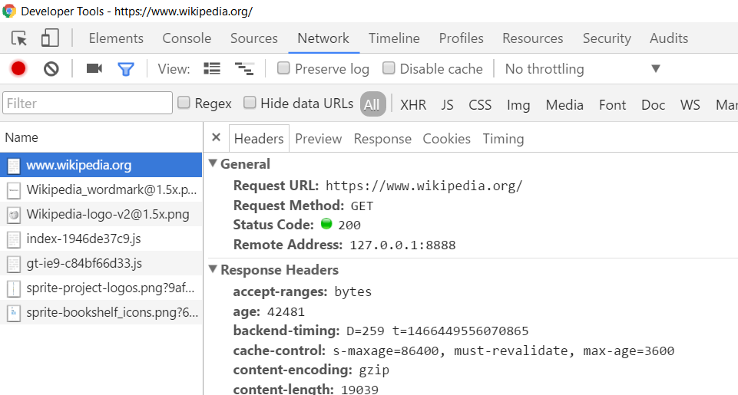
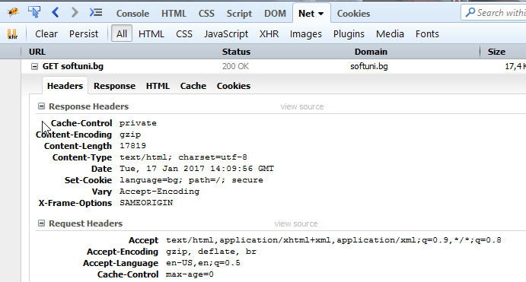

HTTP Tools for Developers
Chrome Developer Tools
Firebug
Postman

Slide 33

Overview of Node.js
History, Components, Installation

Slide 34
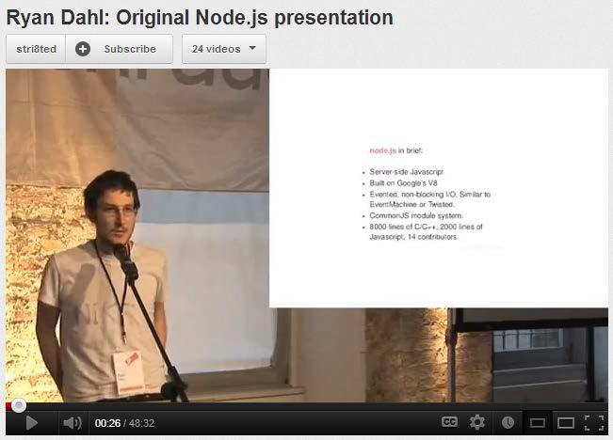

Overview of Node.js
History and Components
Created in 2009 by Ryan Dahl
Addresses the issues of then popular servers
V8, Event Loop, libuv
Advantages
One language for server and client
Fast and asynchronous
Efficient package manager

Slide 35
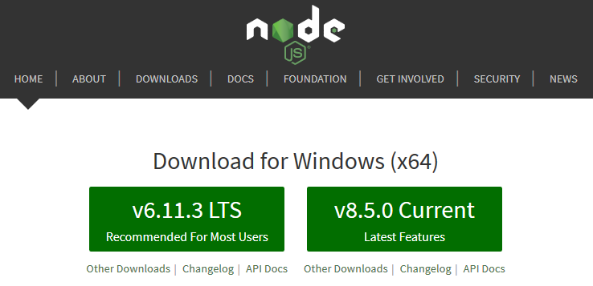
Installation
Installation
Go to http://nodejs.org
To confirm installation, type in command prompt (terminal):
node -v

Slide 36
How to Use
From the terminal
Interpret code from a file
Save script to index.js
Execute from the terminal:
node // Start REPL
let a = 5
let b = 3
a + b // 8
node index.js // 8

Slide 37
NPM Packages
Node.js projects are usually set up as NPM packages
From the terminal, inside the target directory :
Answer questions to initialize project
A package.json file will be created with initial configuration
To bypass all questions (take default values):
npm init
npm init -y

Slide 38
Configuration (package.json)
{
"name": "demo",
"version": "1.0.0",
"description": "Node.js demo project",
"main": "index.js",
"engine": "8.5.0",
"scripts": {
"start": "node index.js"
},
"keywords": [],
"author": "",
"license": "ISC“
}
Target version on the server
Aliases for executing
node commands

Slide 39
Using Modules
Making Our App Modular

Slide 40
What is a Module?
persons.js
class Person {
constructor(name) {
this.name = name;
}
toString() {
return `I'm ${this.name}`;
}
}
module.exports = Person;
app.js
let Person = require('./person');
let p = new Person('Pesho');
console.log(p.toString());

Slide 41
How To Use Modules
Modules allow larger apps to be split and organized
To expose a module
To use a module from another file
module.exports = Person;
module.exports = { getById, getAll, update };
let Person = require('./Person');
let api = require('./api');
let getById = require('./api').getById;
let { getById } = require('./api');

Slide 42
Built-in Modules
Node.js comes with a plethora of useful modules
Imported with a string identifier
Commonly used modules
fs, http, crypto, os
More at https://nodejs.org/api/
const fs = require('fs');

Slide 43
Your Modules
first.js
let count = 2;
let doIt = function(i, callback) { … }
module.exports.doIt = doIt;
module.exports.someVar = 'result';
second.js
const one = require('./first');
one.doIt(23, function (err, result) {
console.log(result);
});
console.log(one.someVar);
console.log(one.count); // invalid

Slide 44
Third-Party Modules
Installed from Node Package Manager (NPM)
Run from the terminal
To use in your code
To install globally (for use from the terminal)
npm install --save express --save-exact
const express = require('express');
npm install --g mocha
44

Slide 45

Node.js Web Server
Let's start the fun!

Slide 46
What Do the Web Servers Do?
All physical servers have hardware
The hardware is controlled by the operating system
Web servers are software products that use the operating system to handle web requests
Web servers serve Web content
These requests are redirected to other software products (ASP.NET, PHP, etc.), depending on the web server settings

Slide 47
A Simple Node.js Web Server
Let's write a simple Node.js web server
const http = require('http');
http.createServer((req, res) => {
res.write('Hi!');
res.end();
}).listen(1337);
console.log('Node.js server running on port 1337');

Slide 48

Live Exercises

Slide 49

Summary
…
…
…
Web Servers transfer resources to the Client
The Node.js is a fast and asynchronous efficient package manager
You can organize your code with modules
NPM allows quick access to external modules
let express = require('express');
npm init -y
npm install --save socket.io

Slide 50
https://softuni.bg/courses/express-js-fundamentals

Slide 51












SoftUni Diamond Partners

Slide 52




SoftUni Organizational Partners

Slide 53




Trainings @ Software University (SoftUni)
Software University – High-Quality Education and Employment Opportunities
softuni.bg
Software University Foundation
http://softuni.foundation/
Software University @ Facebook
facebook.com/SoftwareUniversity
Software University Forums
forum.softuni.bg

Slide 54

License
This course (slides, examples, demos, videos, homework, etc.) is licensed under the "Creative Commons Attribution-NonCommercial-ShareAlike 4.0 International" license

